Slide 1
Archetype Modeling Language (AML)
Presentation to HL7/OMG Joint Working Group

Slide 2
Outline
CIMI and AML
AML – Purpose and Goals
OMG, UML, and UML Profiles
AML Submission overview
State of current submission

Slide 3
CIMI and AML

Slide 4
Clinical Information Modeling Initiative (CIMI)

Slide 5
Clinical Information Modeling Initiative Mission
Improve the interoperability of healthcare systems through shared implementable clinical information models.
(A single curated collection.)

Slide 6
Clinical Information Modeling Initiative Goals
Shared repository of detailed clinical information models
Using a single formalism
Based on a common set of base data types
With formal bindings of the models to standard coded terminologies
Repository is open and models are free for use at no cost

Slide 7
Clinical Information Modeling Initiative Models that support multiple contexts
EHR data storage
Message payload and service payload
Decision logic (queries of EHR data)
Clinical trials data (clinical research)
Quality measures
Normalization of data for secondary use
Creation of data entry screens (like SDC)
Capture of coding output from NLP

Slide 8
Strategic Goal
Be able to share data, applications, reports, alerts, protocols, and decision support modules with anyone in the WORLD
Goal is “plug-n-play” interoperability

Slide 9
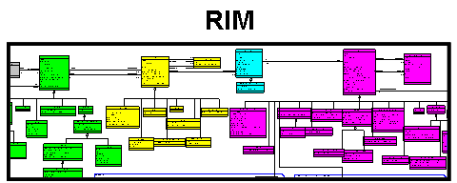
CIMI Repository
Standard
Terminologies
And Ontologies
CEM
V2 “|”
LRA
V2 XML
HTML
CEMs
V3 XML
DCMs
FHIR
Repository of Shared
Models in
an approved Formalism
Translators
Realm
Specific Specializations
Translators
AML
Realm
Specific Specializations
Translators
CDA
Templates
Realm
Specific Specializations
Realm
Specific Specializations
Localization and Context Specialization
ADL
openEHR
Archetypes
CDA
OWL
ISO EN 13606
Archetypes
LRA
Models
CDISC
SHARE
SOA
Payload
FHIR
Resources
CEN
Archetype
Initial Loading of Repository

Slide 10
CIMI Repository
Standard
Terminologies
And Ontologies
CEM
V2 “|”
LRA
V2 XML
HTML
CEMs
V3 XML
DCMs
FHIR
Repository of Shared
Models in
an approved Formalism
Translators
Realm
Specific Specializations
Translators
AML
Realm
Specific Specializations
Translators
CDA
Templates
Realm
Specific Specializations
Realm
Specific Specializations
Localization and Context Specialization
ADL
openEHR
Archetypes
CDA
OWL
ISO EN 13606
Archetypes
LRA
Models
CDISC
SHARE
SOA
Payload
FHIR
Resources
CEN
Archetype
Initial Loading of Repository

Slide 11
Selected CIMI Policies, decisions, and milestones

Slide 12
London, Dec 1, 2011
ADL 1.5 as the initial formalism, including the Archetype Object Model
A CIMI UML profile (Archetype Modelling Language, AML) will be developed concurrently as a set of UML stereotypes, XMI specifications and transformations

Slide 13
Terminology
SNOMED CT is the primary reference terminology
LOINC is also approved as a reference terminology
In the event of overlap, SNOMED CT will be the preferred source
CIMI will propose extensions to the reference terminologies when needed concepts do not exist
CIMI will have a place to keep needed concepts that are not a part of any standard terminology
CIMI has obtained a SNOMED extension identifier
CIMI will adhere to IHTSDO Affiliate’s Agreement for referencing SNOMED codes in models
Copyright notice in models, SNOMED license for all production implementations
CIMI will create a Terminology Authority to review and submit concepts to IHTSDO as appropriate

Slide 14
Terminology (cont)
The primary version of models will only contain references (pointers) to value sets
We will create tools that read the terminology tables and create versions of the models that contain enumerated value sets (as in the current ADL 1.5 specification)

Slide 15
The Ultimate Value Proposition of CIMI
Interoperable sharing of:
Data
Information
Applications
Decision logic
Reports
Knowledge

Slide 16
AML Purpose and goals

Slide 17
Archetype Modeling Language RFC (AML)
Goal:
“Create a standard for modeling Archetype Models (AMs) using UML, to support the representation of Clinical Information Modeling Initiative (CIMI) artifacts in UML. “

Slide 18
AML Profiles Profiles Called for in RFP
Reference Model Profile(RMP) - enable the specification of reference models, upon which archetypes can be based
Constraint Model Profile(CMP) - support the specification of constraints on a given reference model, to enable the development of archetypes, including Clinical Information Models (CIMs)
Terminology Binding Profile (TBP) - support the binding of information models to terminology, with optional support for binding to CTS2.

Slide 19
AML Profiles Additional Profiles Described in Submission
Archetype Profile – Archetype Library, Archetypes and Archetype Versions
Rules Profile – define a common constraint profile, compatible with a subset of OMG Object Constraint Language (OCL) and covering ADL Rules..
Identification and Designation – Link to ISO 11179
Metadata Profile – description and state of model artifacts. Who, what, why, where, when…

Slide 20
Initial Submission
Addresses archetype, reference model, constraint model, terminology binding profile identification and designation and metadata profile
Rules (OCL) out of scope for current submission
Rules is is a not-insignificant task
Harmonization may be an issue

Slide 21
What are “Archetypes”?

Slide 22
“Top Down” Modeling
Additive
Start with most abstract
Specialize adding properties and relationships
Instances only valid at selected level up

Slide 23
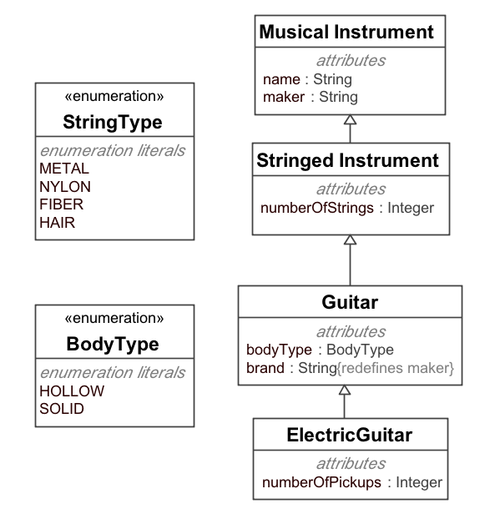
“Top Down” Modeling

Slide 24
“Top Down” Modeling
<MusicalInstrument name=“Guitar”
maker=“Gibson/>

Slide 25
“Top Down” Modeling
<MusicalInstrument name=“Guitar”
maker=“Gibson/>
<StringedInstrument name=“Guitar”
maker=“Gibson
numberOfStrings=“6”/>

Slide 26
“Top Down” Modeling
<MusicalInstrument name=“Guitar”
maker=“Gibson/>
<StringedInstrument name=“Guitar”
maker=“Gibson
numberOfStrings=“6”/>
<Guitar name=“Guitar”
brand=“Gibson
numberOfStrings=“6”/>
<ElectricGuitar name=“Guitar”
brand=“Gibson
numberOfStrings=“6”
numberOfPickups=“3”/>

Slide 27
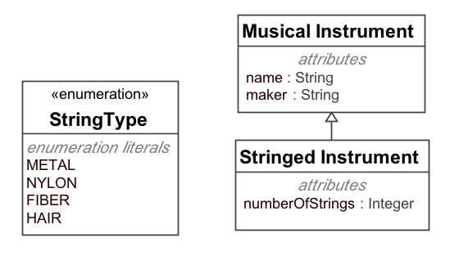
“Top Down” Modeling
← If this is my model …
<ElectricGuitar name=“Guitar”
brand=“Gibson
numberOfStrings=“6”
numberOfPickups=“3”/>
← … this makes no sense!

Slide 28
Constraint or “Bottom Up” Modeling
Start with general model
Becomes the most abstract level of exchange
Specialize by restriction
Cardinality
Value and value ranges
Optional → mandatory / prohibited
Enumeration subsets
Renaming

Slide 29
Constraint Based Models
Start with UML “Reference Model” that defines the most abstract level of exchange
Add constraints (restrictions) on reference model
Can serve as detailed type checking for input
Can serve as a generic grammar (!)
Can function as a query language

Slide 30
Constraints as a Grammar
Without
Abnormal HCT == lab result with code ‘1234-5’, abnormal flag set? Result > specified value?
Information is coded in applications(!)
Brittle
Rigid
With
Abnormal HCT == {set of constraints}
Applications reference model

Slide 31
Constraints
Need a grammar/interchange format
ADL 1.5.1 suites the bill well
UML XML (once AML is complete)
Tooling
ADL Workbench / Clinical Knowledge Manager
UML Tools (once AML is complete)
Representational forms
ADL WB / Mindmaps / JSON / XML / …
UML Profile / Model tools

Slide 32
OMG, UML, and UML Profiles

Slide 33
Object Management Group (OMG)
Standards consortium
Home to UML and Model Driven Architecture (MDA)
“No Shelf-ware” policy – standards must be accompanied by implementations
Platform Technical Committees – architecture, tools, middleware
Domain Technical Committees – “vertical” domains (Healthcare, Manufacturing, Robotics, Space, …)

Slide 34
UML
A standard for representing and exchanging models
A model of models (a “metamodel”)
“Class”, “Property”, “Generalization”, “Association”
Representation for elements (An instance of a “Class” is represented as a box with separate slots…”
Model of model exchange

Slide 35
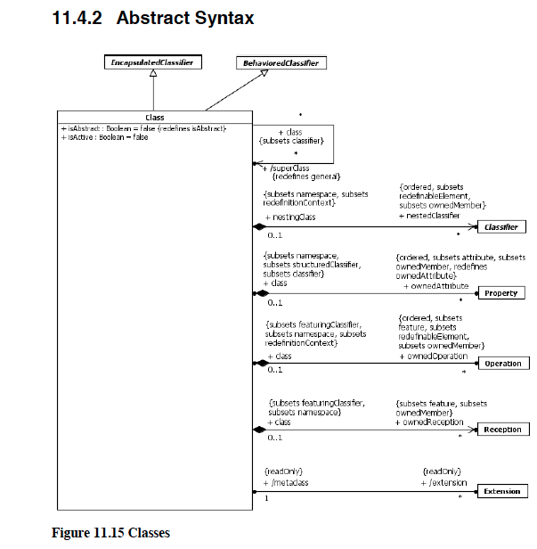
Model of “Class”

Slide 36
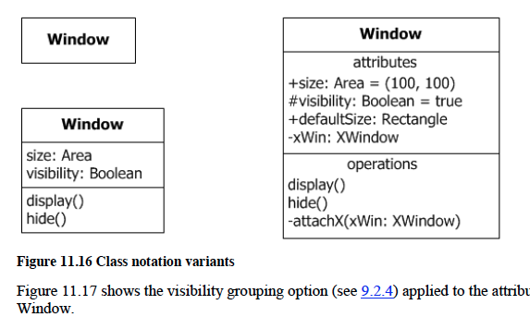
Representation of “Class”

Slide 37
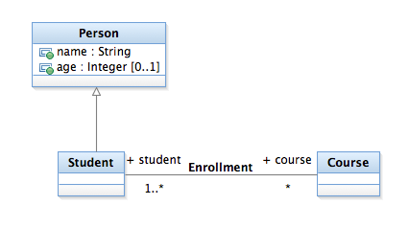
UML Model Instance

Slide 38
UML Model Instance
Class

Slide 39
Instances
Property
Generalization
Relationship

Slide 40
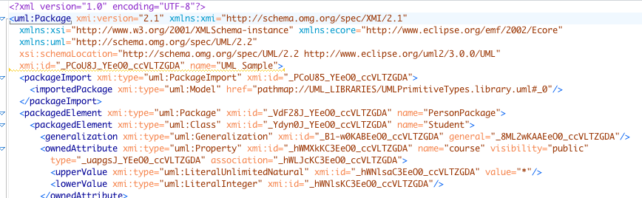
Model Interchange

Slide 41
UML
Good at general, “extensible” models
NOT so good at “constraint” models
Extensible – elements the metamodel itself can be extended as a “Profile”

Slide 42
Extension
‘Particularization’ of UML by specializing some of its elements, imposing new restrictions on them but respecting the UML metamodel, and without modifying the original semantics of the UML elements (i.e., the properties of the UML classes, associations, attributes, etc., will remain the same, but new constraints will be added to their original definitions and relationships).

Slide 43
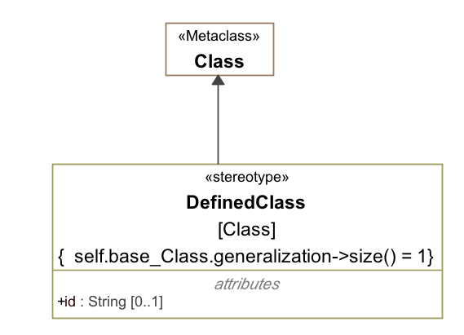
Extension
Restriction
Tag

Slide 44
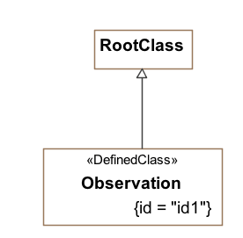
Using a Stereotype (extension)

Slide 45
Profile
Collections of Stereotypes and Classes
Semantics of the above
Suggestions for representation and use
The (or “A”) GOAL is to have UML model vendors incorporate profiles as first class items into their tools…

Slide 46
OMG Standards Process

Slide 47
OMG RFP Process
TC issues RFP – requirements document
Organizations submit responses
Initial submission – draft responses shown, discussed.
Final submission – (typically) one harmonized fesponse
Response(s) are balloted
Accepted response becomes a Beta Specification / Finalization Task Force formed
FTF report submitted and Beta Specification becomes a final specification.
Members Only
Public

Slide 48
AML Submission
Boilerplate (Chapters 1-7)
Metamodel – (Chapter 8) what we are trying to do
Profiles – (Chapter 9…) how we do it (profiles)

Slide 49
AML Submission AML Object Model
Reference Model
Examples
AOM 1.5.1
Archetype Model
UML 2.5
Constraint Model
CTS2 1.1
Terminology Model
ADL .1
Rules Model
Metadata Model
ISO 11179-3

Slide 50
AML Submission Profiles
Reference Model
Examples
Ref. Model Profile
Examples
Archetype Model
Archetype Profile
Constraint Model
Constraint Profile
Terminology Model
Terminology Profile
Rules Model
Rules Profile
Metadata Model
Identification and Designation
ADL Metadata
AML Object Model
Profile

Slide 51
AML Submission overview

Slide 52
Reference Model Profile

Slide 53
Reference Model Object Model
Identify the subset of UML that will be recognized by AML
Class
Property (SingularProperty / CollectionProperty
DataType (UML Sense)
Enumeration
PrimitiveType
ConceptReference
Namespace / Package

Slide 54
Reference Model Profile
Identify the “primitive” types that can be constrained
Boolean, String, Integer, Real
DateTime, Date, Time, Duration
Provide stereotypes to identify components of the reference model that are constrained by the Profile primitive types
Provide abstract types that need to be realized in any model
ArchetypeId, ArchetypeVersionId, ArchetypeMetadata

Slide 55
Archetype Profile

Slide 56
Archetype Profile
Archetype Library : a collection of archetypes that apply to the same reference model
Archetype : a constraint applied to a specific class in a reference model
ArchetypeVersion : the state of a constraint at a point in time

Slide 57
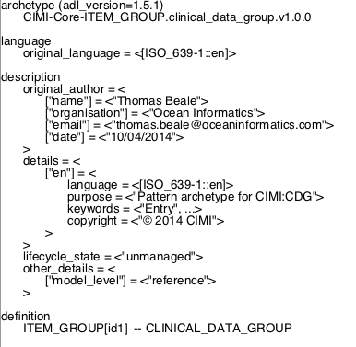
ADL

Slide 58
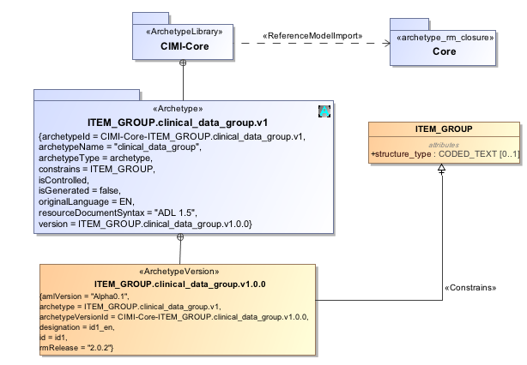
AML

Slide 59
Constraint Profile

Slide 60
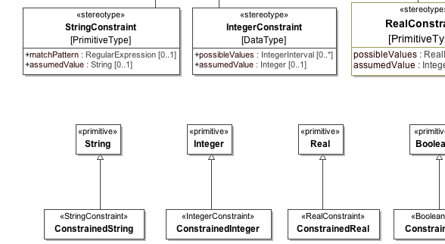
“Primitive Type” Constraints

Slide 61
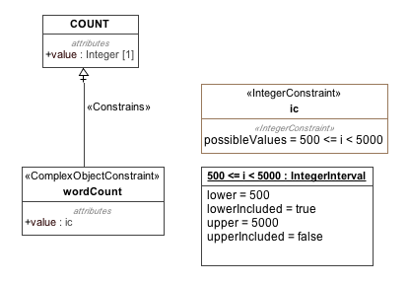
“Primitive Type” Example
Issue --

Slide 62
Constraint Profile
Root is ObjectConstraint – a class with:
Exactly one superclass (either reference model class or another ObjectConstraint)
No additional attributes
Can only “subset” or “redefine”

Slide 63
Constraint Types Object Constraints
ComplexObject: constrains class properties (i.e. attributes and relationship targets)
PrimitiveObject: constrains ranges, content, sizes, etc. of data types
Enumeration: constrains members of enumerations
Slot: constrains types of ‘imported’ constraints
Proxy: references to external constraint

Slide 64
Constraint Types Attribute Constraints
Constraints on UML properties
SingularAttributeConstraint ([0..1],[1..1])
Alternative
Presence (required / prohibited)
AttributeCollectionConstraint([x..*])
Cardinality: total # of instances
Subsets: n..m instances of type A, n..m of B, etc.

Slide 65
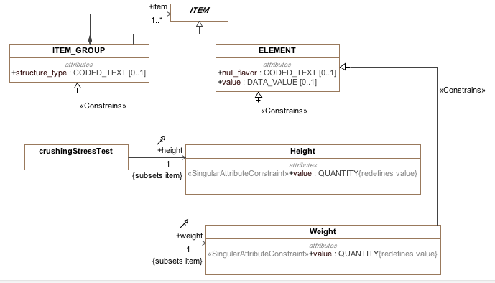
Constraint Example

Slide 66
Identification and Designation profile

Slide 67
Identification and Designation
Advised by ISO 11179-3
IdentifiableItem
Namespace + id
DesignatableItem
Language + sign + [description]
Namespaces
“meaning” linkage from Class

Slide 68
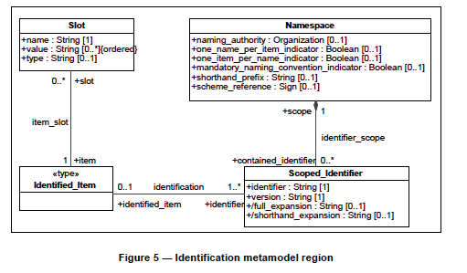
11179-3 Identification

Slide 69
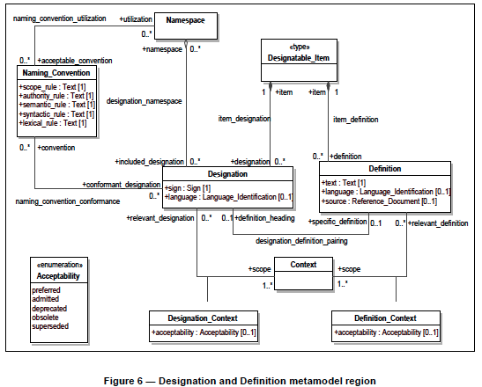

Slide 70
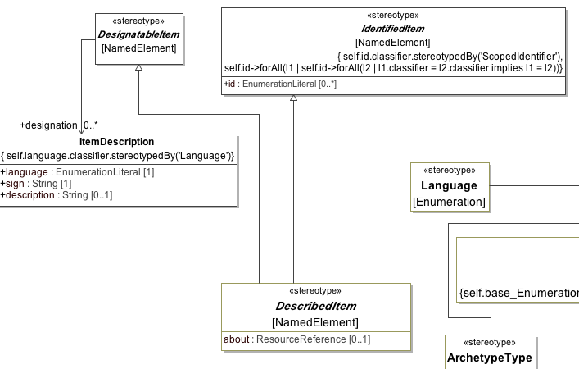
Designatable/Identified/Described
Note:

Slide 71
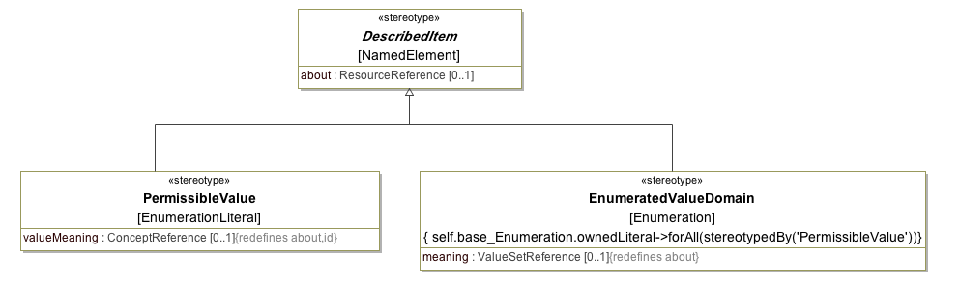
EnumeratedValueDomain and PermissibleValue

Slide 72
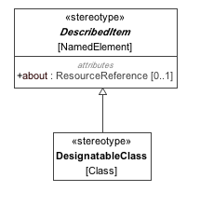
Identification and Designation in Action
Any UML NamedElement can
Be marked as “Described”

Slide 73
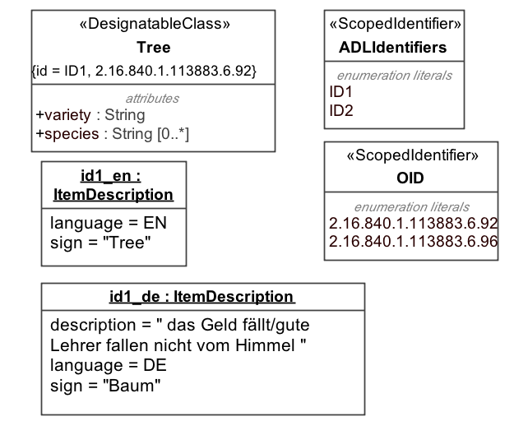
Identification and Designation in Action

Slide 74
Terminology binding Profile

Slide 75
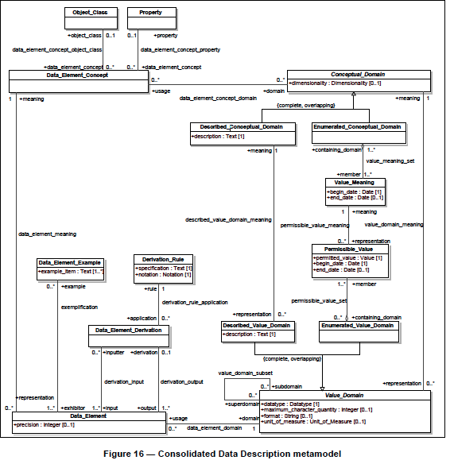

Slide 76
Meaning
Representation

Slide 77
ADL Terminology
Term Definitions Section
Covered in Identification and Designation
Term Bindings Section
Covered in Identification and Designation about item (see note earlier)
Value Sets Section

Slide 78
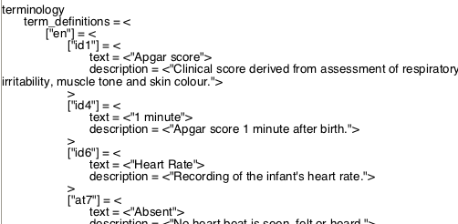
ADL Terminology Term Definitions
Identifier
ItemDescription

Slide 79
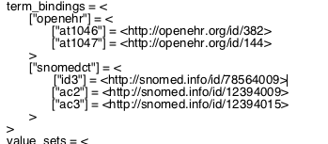
ADL Terminology Term Bindings

Slide 80
ADL Terminology Term Bindings

Slide 81
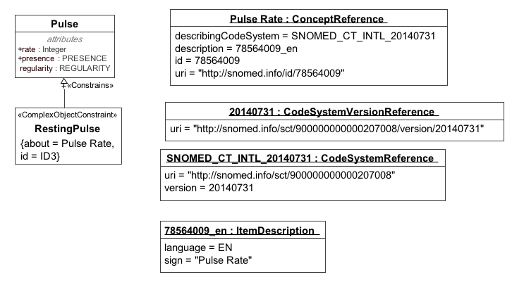
Term Bindings Example

Slide 82
Value Sets
Three Flavors
Local – Equivalent to UML Enumeration
External – Reference to Externally Defined Value Set
Mapped Value Set
Local Permissible Values (enumeration)
External “value meaning”

Slide 83
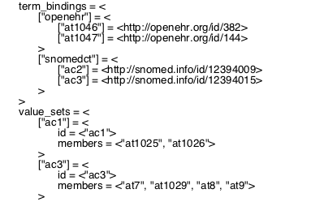
ADL Terminology Local Value Sets

Slide 84
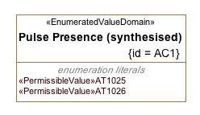
Local Value Set

Slide 85
ADL Terminology External Value Set

Slide 86
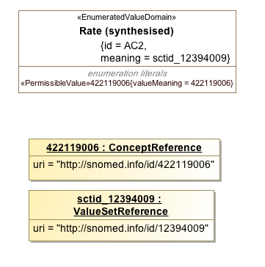
External Value Set

Slide 87
ADL Terminology Mapped Value Set

Slide 88
Mapped Value Set
What do we use for ‘permissible value’?
Local identifier
Concept identifier
How does this evolve?
More to come when we examine instance data

Slide 89
State of current submission

Slide 90
OMG Process
TC issues RFP – requirements document
Organizations submit responses
Initial submission – draft responses shown, discussed.
Final submission – (typically) one harmonized response
Response(s) are balloted
Accepted response becomes a Beta Specification / Finalization Task Force formed
FTF report submitted and Beta Specification becomes a final specification.
Members Only
AML
Public

Slide 91
Where we are
AML RFP Issued – June 2012
LOI Deadline – January 14, 2014
VA, Mayo, SemantX, The Software Revolution, Visumpoint
Initial submission – Feb 24, 2014
One joint submission received
Submission presented to OMG – March 27, 2014
Revised submission – May 19, 2014 (missed) Revised submission – Nov 8, 2014
AML

Slide 92
References
RFP
http://www.omg.org/techprocess/meetings/schedule/AML_RFP.html
Initial Submission
http://www.omg.org/cgi-bin/doc?health/14-02-01
ADL 1.5
https://github.com/openEHR/specifications/blob/master/publishing/architecture/am/adl1.5.pdf
AOM 1.5
https://github.com/openEHR/specifications/blob/master/publishing/architecture/am/aom1.5.pdf
UML 2.5
http://www.omg.org/cgi-bin/doc?ptc/13-09-05.pdf
GIT Repository
https://github.com/opencimi/AML

